Slide 1
The Use of Private and Public Cameras in a Community-based
Illegal Dumping Pilot Project
April 23 2021
Alyce Sandbach, DDA

Slide 2
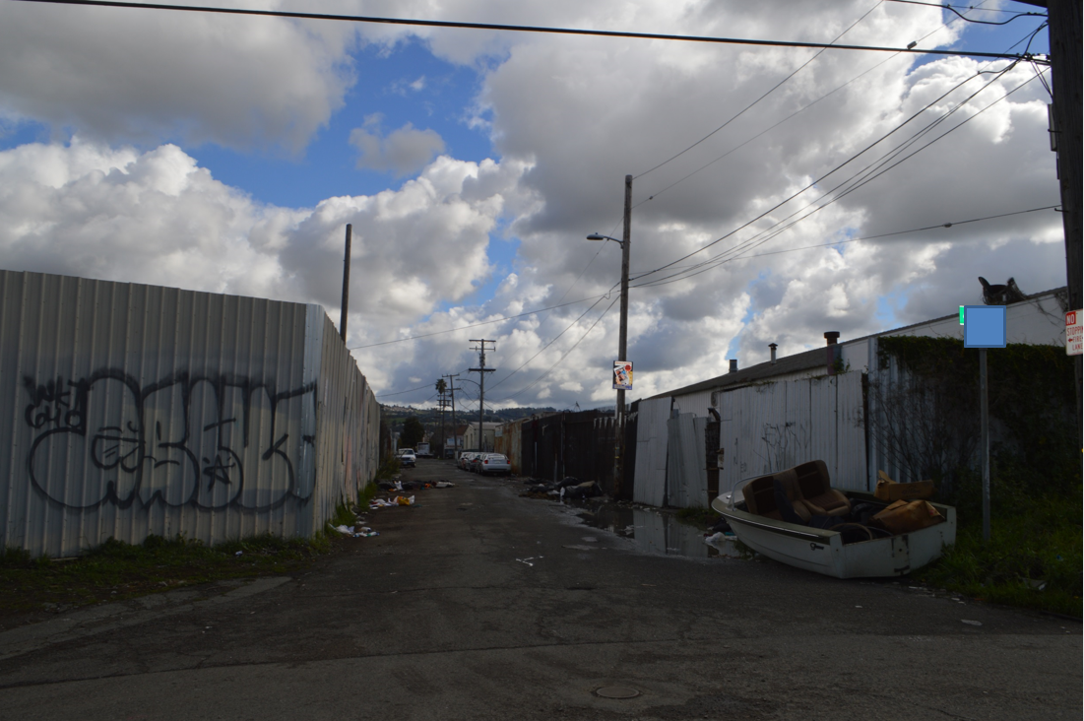
Typical day at the beginning of the Pilot, 2019

Slide 3
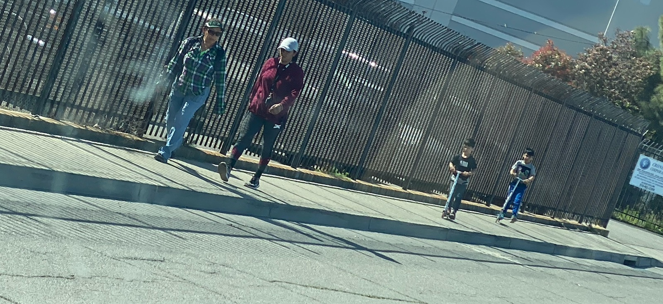
March 27, 2021

Slide 4
Illegal dumping cases without supporting evidence from cameras are rare.
Cases in pilot skyrocketed after cameras installed.

Slide 5
Enforcement Model:
Clean-up crews provide info re source of waste.
Cameras provide info re car, suspects.
DA , ACSO, or City investigate and can pursue misdemeanor, infraction, fine, or warning (felony if hazardous waste).
Clean-up crew may also warn and not refer.

Slide 6
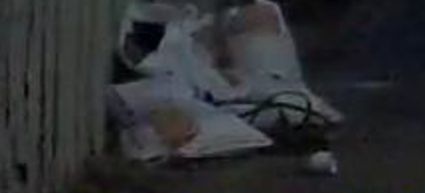
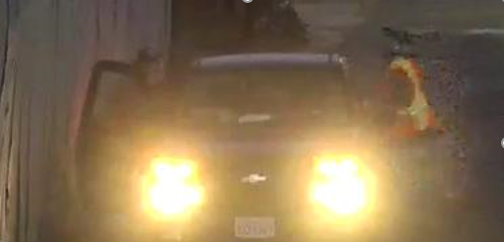
A few examples

Slide 7
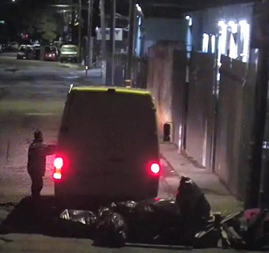

Slide 8
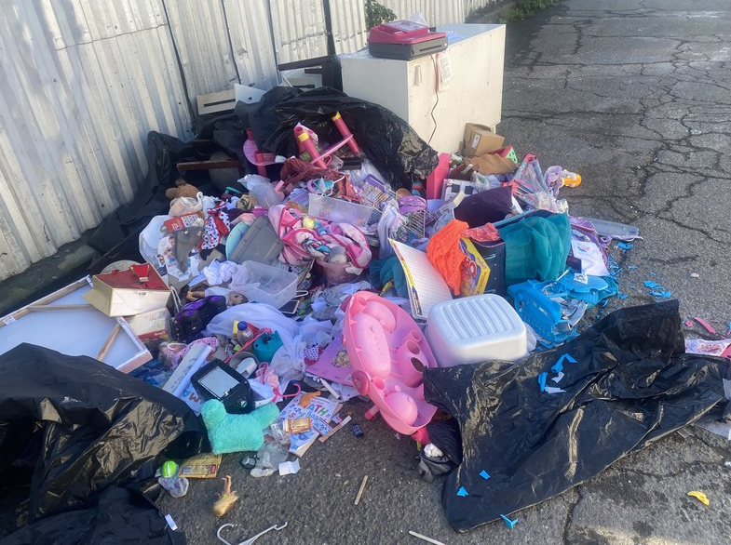
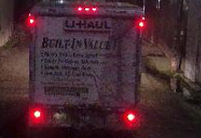

Slide 9
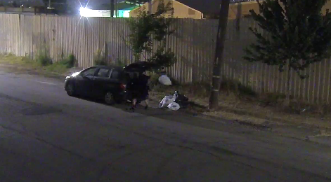

Slide 10
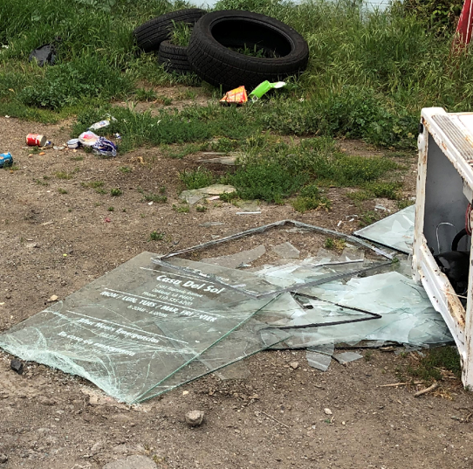
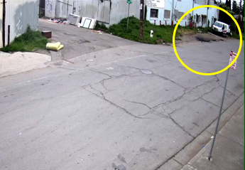
Beautification Council/Ken Houston alerts DA to dumped glass with traceable markings. Glass was dumped by man hired to replace
windows at local restaurant. Subject admits to DA Inspector.

Slide 11
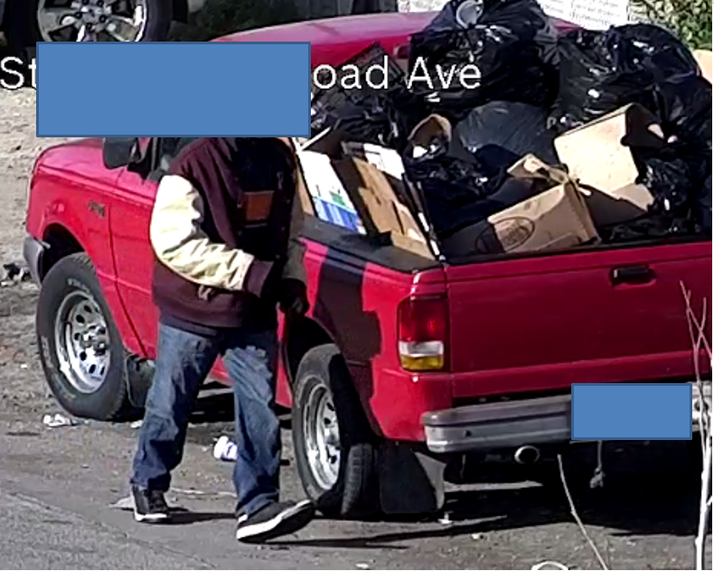

Slide 12
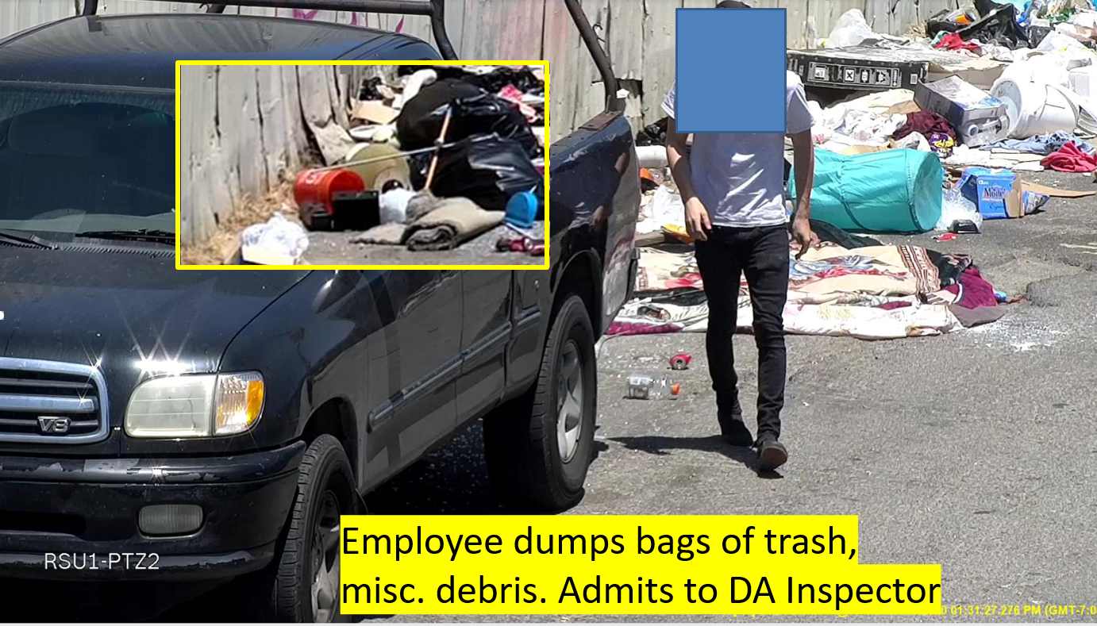
March 27, 2021

Slide 13
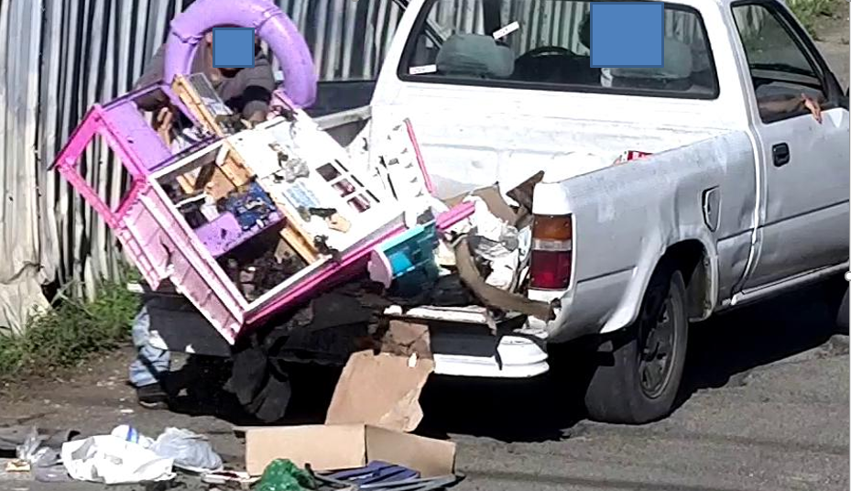

Slide 14
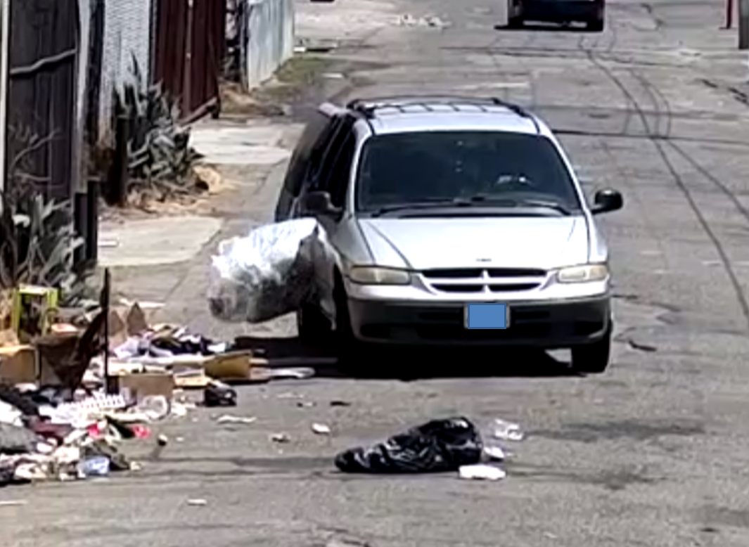

Slide 15
Clean-up crews supplement cameras by providing key evidence re source of trash:
    “Indicia,” such as mail, receipts, prescriptions.
    Evidence re nature of trash: e.g., construction, restaurant, roofing, landscaping, household, etc.
Evidence in addition to camera footage?

Slide 16
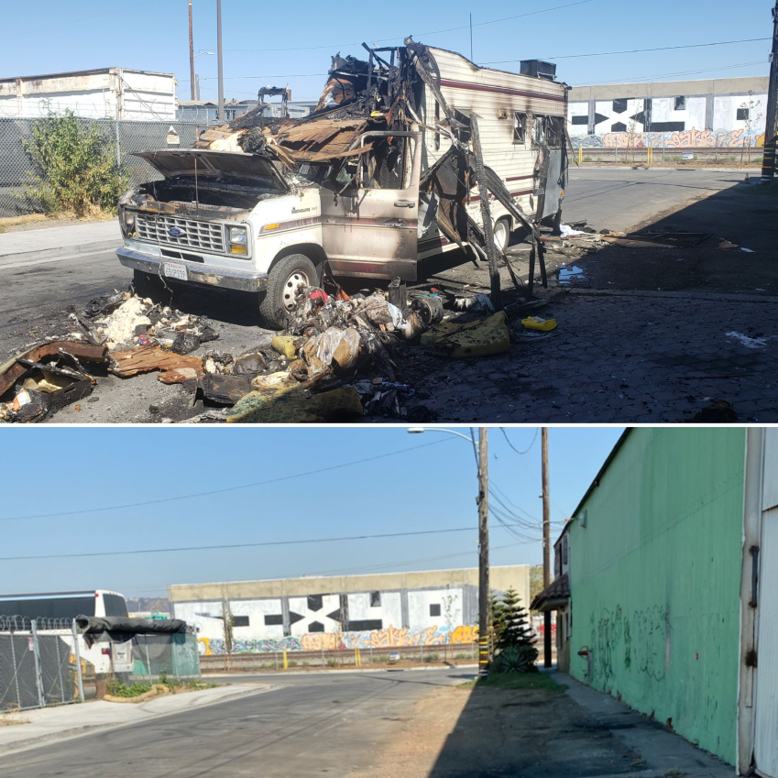
:
KEY POINT:
Argent Materials cleans up (very) hot spots where there are no cameras.
Without cameras, we’d have very little enforcement of illegal dumping – and little means of encouraging such clean-up efforts by local businesses

Slide 17
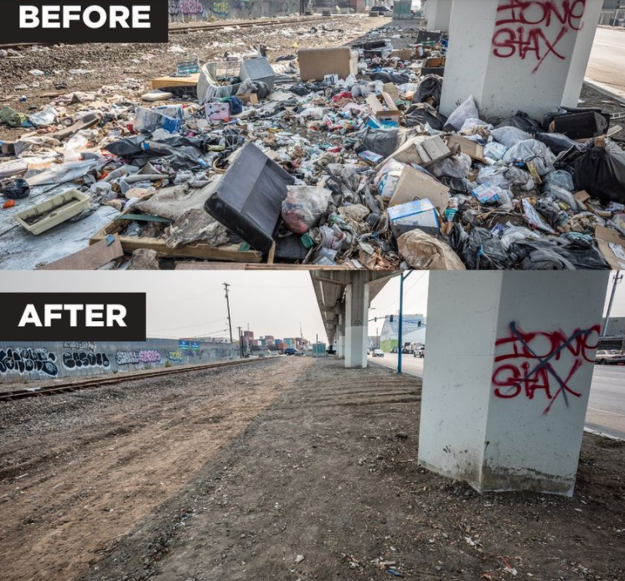
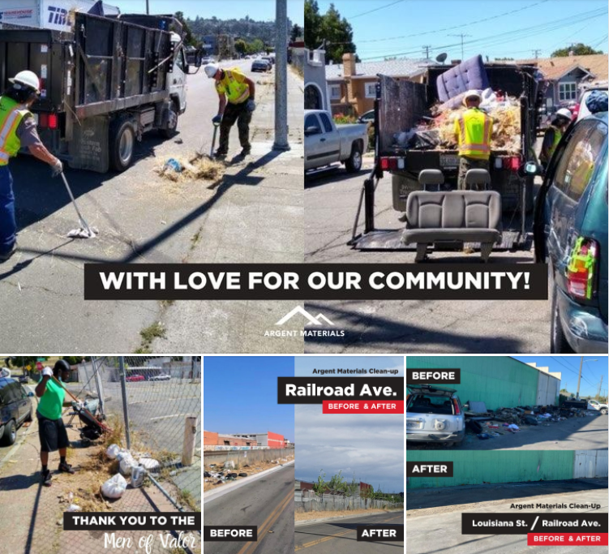
Local business cleans up tremendous amounts of trash at hot spots without cameras …

Slide 18
Stolen cars, stolen packages/mail.
Deconfliction between ACSO, DA, City of Oakland.
Images at night.
Relevant laws.
Deterrence: Getting the message out.
Additional issues

Slide 19
The Use of Private and Public Cameras in a Community-based
Illegal Dumping Pilot Project
Alyce Sandbach, DDA
Alyce.Sandbach@acgov.org

