Slide 1

Virtual Statewide Conference on Illegal Dumping
April 23, 2021
NSAC'S VISION: The United States attains a circular economy.
© copyright National Stewardship Action Council, 2021
Notes:
Story about how each person listening can be a catalyst for the change to a circular economy.
Disruption is a word with a negative connotation – but not here. We CANNOT keep doing what we are doing and without disruption we will not succeed in change!
Change is for the better..
Tell the story of my career, how I have become a catalyst for the CE and empower everyone to do the same. It will take all of us.
Linear conversation to a circular conversation and take, make waste to CE.

Slide 2

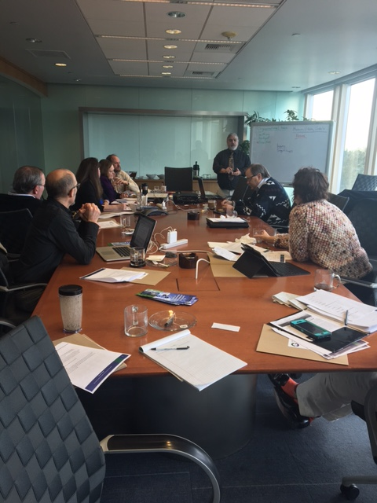
Who is NSAC?
The National Stewardship Action Council (NSAC) is a 501©4 non-profit organization. NSAC is a network of committed proponents comprised of governments, non-government organizations, businesses, and consumers who advocate that producers fairly share responsibility in a circular economy.
Vision: The United States attains a circular economy.
Mission: Collaborate with public and private stakeholders to advance product stewardship and extended producer responsibility.
2017 NSAC Strategic Planning Meeting
© copyright National Stewardship Action Council, 2021

Slide 3
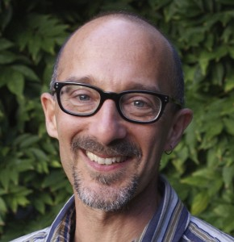

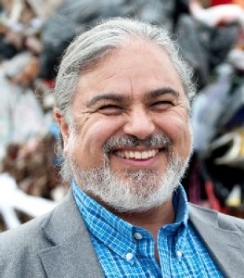




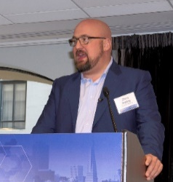
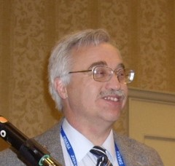

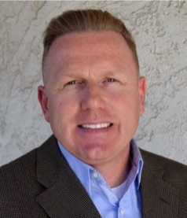
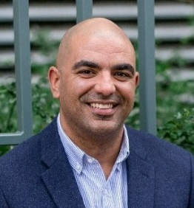
NSAC Board/Organization
12 Board Members, 5 women, 5 BIPOC
David Stitzhal
President
Full Circle Environmental
Patty Garbarino
Treasurer
Marin Sanitary Service
Tim Goncharoff
Vice-President
County of Santa Cruz
Michael Simpson
City of Los Angeles
Constance Hornig
Secretary
Constance Hornig Law Offices
Rubi Rajbanshi
Terrascope Consulting
Bob Gedert
Consultant
Maia Corbitt,
Garver, Black, Hilyard Family Foundation
Chris Ripley
Smarter Sorting
Nicholas Oliver
State of California Department of Consumer Affairs
Beverly Hanstrom
CEO Colorado Medical Waste
Eric Zetz
Merced Regional Waste Mgmt Authority
© copyright National Stewardship Action Council, 2021
Notes:
We just added 5 new board members, 4 people of color – why? So we can be more reflective of our society!

Slide 4
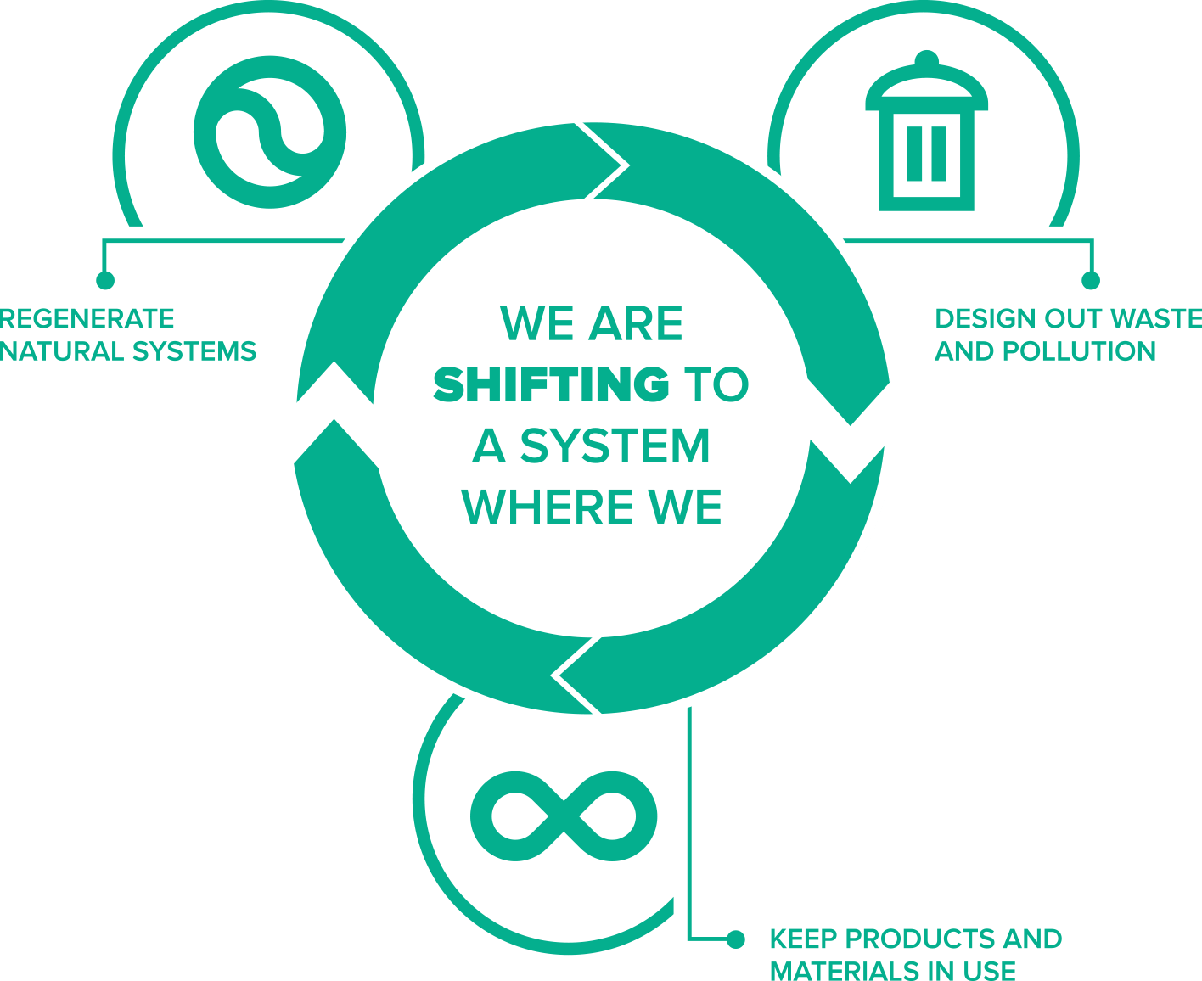

What is a Circular Economy?
Not Linear Make, Take, Waste – but circular: Cradle to Cradle.
Multi-faceted with a focus on producers embracing sustainable design, using regenerative materials and collecting end of life products and materials for continuous use in the economy. It is based on three principles:
#1
#2
#3
© copyright National Stewardship Action Council, 2021
Notes:
Instead of a linear economy of take, make, waste, its circular -
Cradle to Grave = linear, Cradle to Cradle is circular…..

Slide 5

Disruption for the Better: Catalyzing Environmental Justice
Illegal dumping disproportionally impacts poor & BIPOC communities
© copyright National Stewardship Action Council, 2021

Slide 6
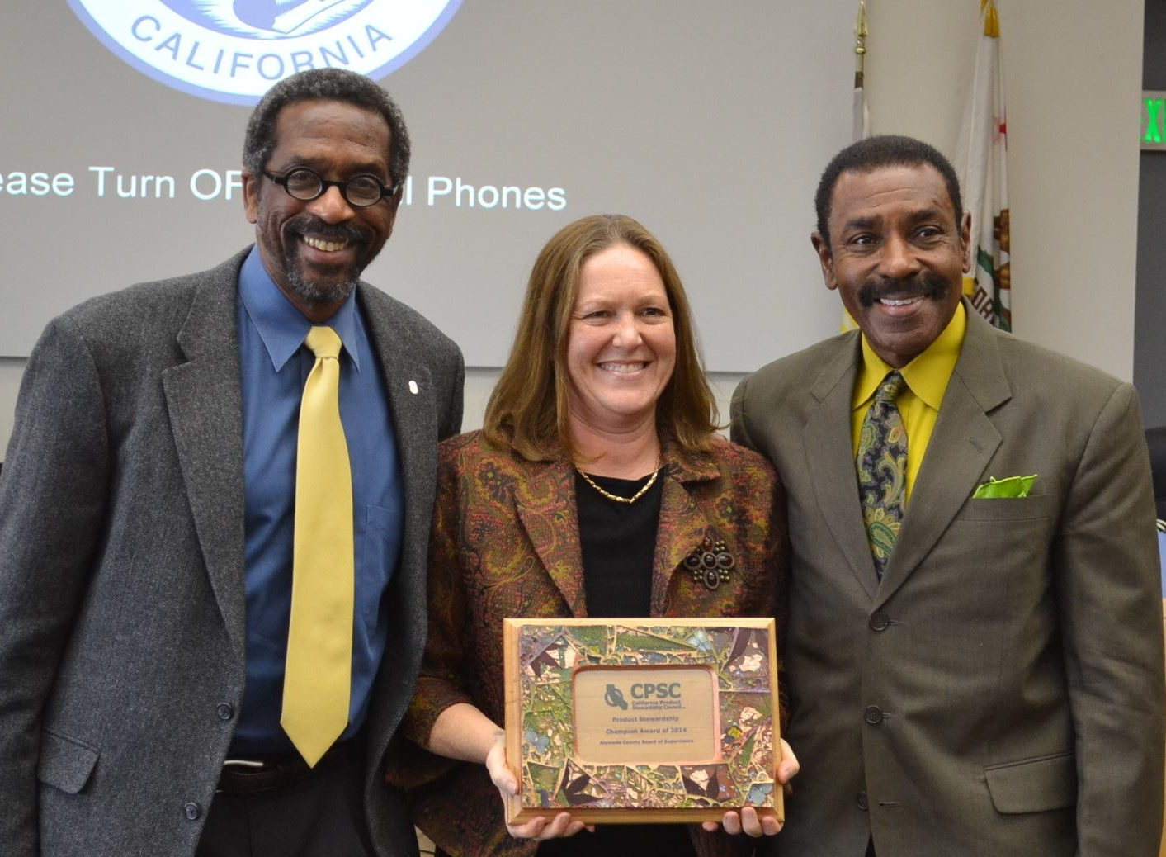
Alameda County Leads the Way:
1st EPR Ordinance in the U.S.
2012: Alameda County adopts first EPR ordinance for medication in U.S.
2014: PhRMA and other plaintiff organizations file a Petition For Writ of Certiorari asking the U.S. Supreme Court to consider the case – Petition text
2015: Denied! NATIONAL IMPACT!
EPR in U.S. allowed so long as the product has a public health and safety nexus
Supervisor Miley, Heidi Sanborn, Supervisor Carson
© copyright National Stewardship Action Council, 2021

Slide 7

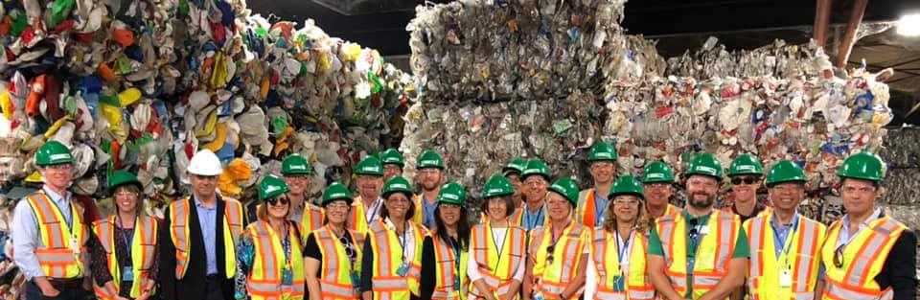
The California Foundation on the Environment and the Economy (CFEE) is a 501(c)(3) nonprofit organization that conducts intensive public policy conferences, legislative briefings, multiparty workshops, and international study travel projects for California State legislators, regulatory commissioners, members of the Governor’s Cabinet, business, labor, environmental and local government leaders. www.cfee.net
© copyright National Stewardship Action Council, 2021
Notes:
Some Examples of Catalyzing the Shift: Another thing we did was catalyze understanding by our legislators in California by taking them to Canada and other states to see how waste management works and do a “deep dive” into policy issues.
We had to pay $21K to join CFEE, $5K for each staffer to be on the trip, and raise $100K in new members to pay for the trip

Slide 8
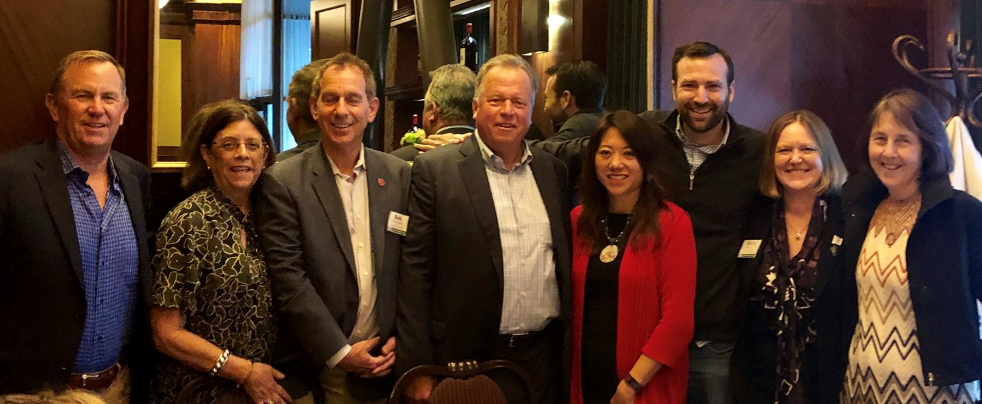
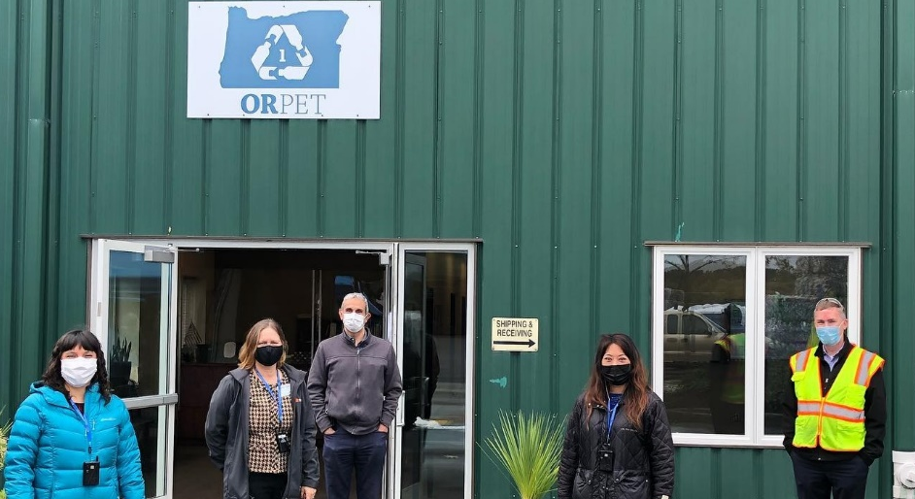
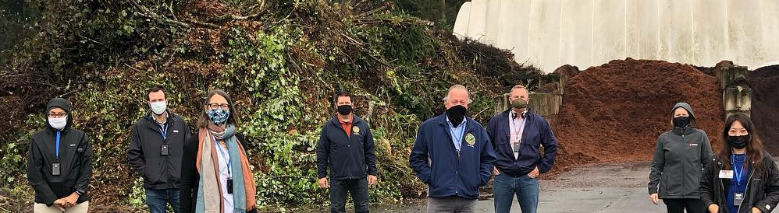
© copyright National Stewardship Action Council, 2021

Slide 9
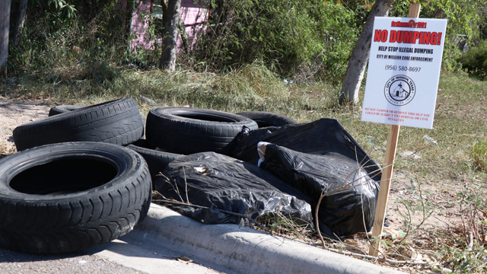
California Tire Program
Consumers pay $1.75 per tire (since 2005)
Funds are used to award grants, loans, and subsidies to businesses or other entities that promote activities or develop technologies for tire recycling. Funds are also used by CARB for air pollution control and prevention. Not actually used to pay to recycle tires.
No cost recovery by local government or solid waste facilities
Concerns about leachate
  Synthetic turf issue having significant impact
© copyright National Stewardship Action Council, 2021

Slide 10

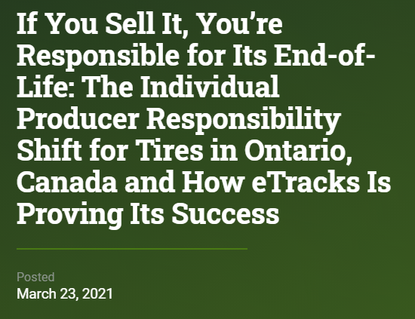
Tire Recycling: Ontario Canada
First material under Ontario’s individual producer responsibility framework (IPR)
Producers are responsible for ensuring used tires are collected and recycled/reused
Often a ~$4 fee charged to consumers per tire at the discretion of a business to recover their costs related to recycling tires
  Embedded in price or visible fee
Six Producer Responsibility Organization (PRO) currently
Beginning in 2019, producers were given a specific target related to the volume of tires they must collect and how much material from those collected tires needs to be recovered and recycled into new products or packaging
© copyright National Stewardship Action Council, 2021
Notes:
I’d read this: https://wasteadvantagemag.com/if-you-sell-it-youre-responsible-for-its-end-of-life-the-individual-producer-responsibility-shift-for-tires-in-ontario-canada-and-how-etracks-is-proving-its-success/
https://www.wasterecyclingmag.ca/tire/ontarians-in-the-dark-about-tire-recycling/1003283983/#:~:text=Most%20Ontarians%20unaware%20of%20tire,when%20purchasing%20new%20car%20tires.

Slide 11
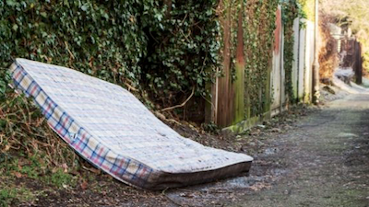

Mattresses
Created by SB 254, signed into law in 2013
Illegally Dumped Mattress Collection Initiative created
  Registered collectors of illegally dumped mattresses will be paid up to $15.00 per unit for data specific to illegal mattress dumping
What could improve CA’s program?
Ensure the producers offer enough financial incentive to cover costs to participate – MRC pushed back and wants mandate on participation without cost recovery
Reimburse counties for costs of collecting abandoned mattresses
Free at end-of-life
Provide more pick-up opportunities for those without transportation
https://byebyemattress.com/
© copyright National Stewardship Action Council, 2021

Slide 12
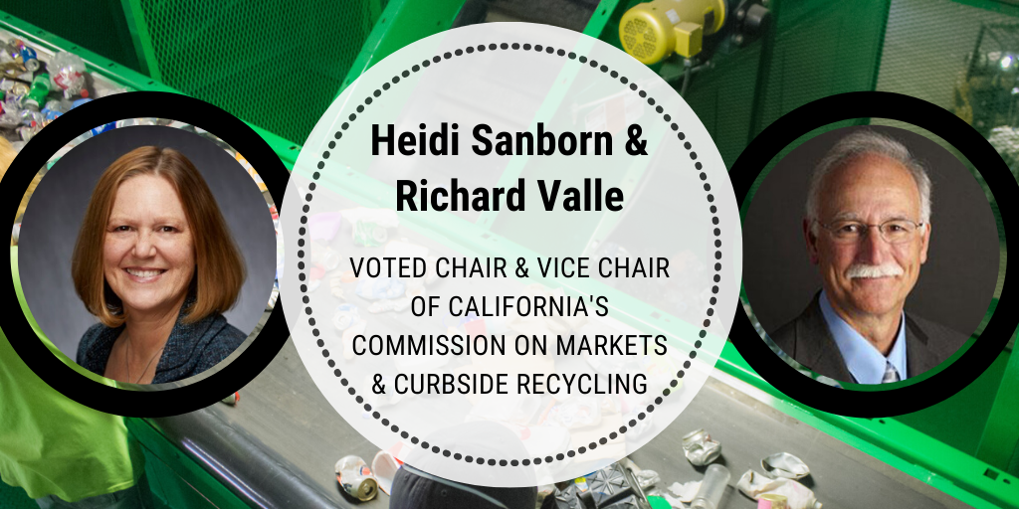
CA Commission on Markets & Curbside Recycling
16 Commissioners
First report submitted 12/2020
Next report due 07/2021
C&D Subcommittee
www.calrecycle.ca.gov/markets/commission
© copyright National Stewardship Action Council, 2021

Slide 13

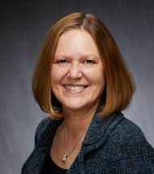




Join us!
Heidi Sanborn
Executive Director
Cell: (916) 217-1109
Heidi@nsaction.us
Connect!
www.nsaction.us
© copyright National Stewardship Action Council, 2021

